Slide 1


The Global State of AMR and What It Means for LMICs
Sam Kariuki
Continental Lead and Director, Drugs for Neglected Diseases Initiative, Africa
and
SPRO, KEMRI

Slide 2
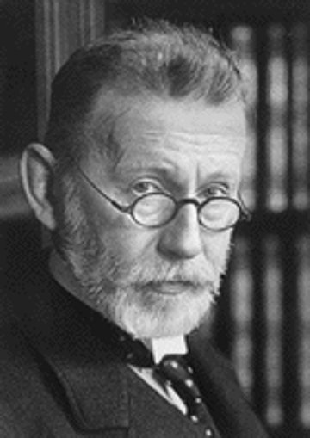
“Drug resistance follows the drug like a faithful shadow.”
- Paul Erhlich 1854-1915
Any use will lead to resistance, it how well we do to delay this emergence and spread that matters!
Disseminating Health Research

Slide 3
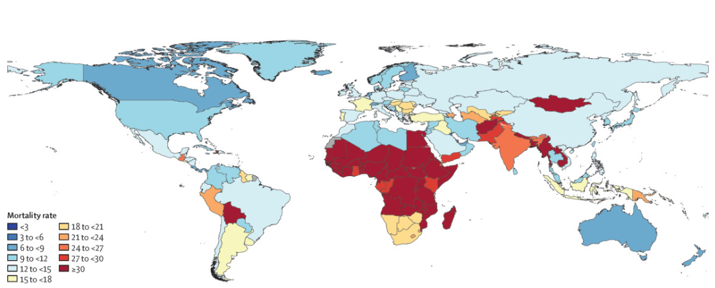
AMR in Global perspective
In 2021, 1·14 million deaths were attributed to bacterial AMR worldwide.
By 2050, AMR is projected to cause 10 million deaths annually if not addressed.
Low- and middle-income countries bear a big burden of the mortalities.
We risk entering a post-antibiotic era.
Naghavi, Mohsen et al.2024

Slide 4
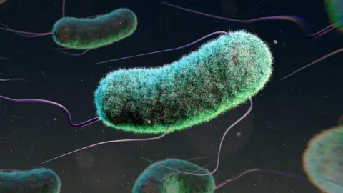
The AMR Crisis and Health in Africa
To put this health crisis in perspective, compare the global impact of COVID-19 to that of AMR:
In 2021 COVID-19 caused 3.55 million deaths worldwide
WHO African region (2019), estimated 1·05 million deaths (95% UI 829 000–1 316 000) associated with bacterial AMR and 250 000 deaths (192 000–325 000) attributable to bacterial AMR (LanGH, 2024)
Africa suffers highest mortality rate from AMR, with 27.3 deaths per 100,000—exceeding the combined death toll from HIV-AIDS, tuberculosis and malaria, ‘African Union Landmark Report’, 2024.
AMR is costing money
Countries across Africa could lose up to 5% of their GDP because of AMR
Three million child deaths linked to drug resistance, study shows Africa and Asia most affected
BBC News, 13 April 2025
Global health correspondent

Slide 5
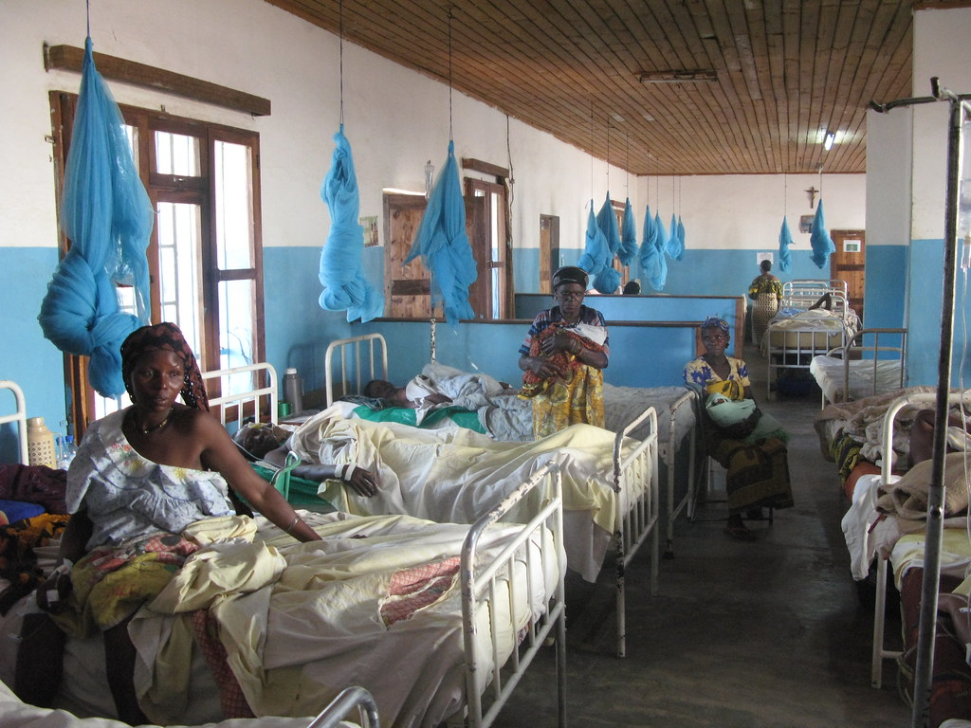
Key characteristics of AMR in Africa
High Mortality: Africa faces the world's highest AMR-related death rates, exceeding those from HIV, TB, and malaria combined.
Major Pathogens: Malaria, tuberculosis (TB), typhoid, cholera, and meningitis.
Drivers: Overuse/misuse of antimicrobials in humans, animals, and agriculture; poor WASH facilities; inadequate infection prevention in hospitals; and lack of quality diagnostics.
Unique Challenges: Africa also struggles with low vaccination rates, compounding the AMR crisis.

Slide 6
Why a "One Health "Approach in AMR?
Antimicrobial Resistance TRULY Global
Antibiotics are used in many settings:
– Clinical medicine, communities, animal husbandry /
aquaculture, horticulture
Same classes of antimicrobial agents are used in
different sectors
Any use will select for resistance
Resistant bacteria and resistance genes do not recognize geographic or ecologic borders

Slide 7
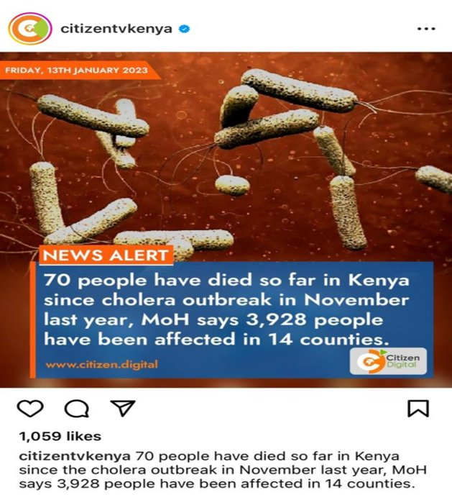
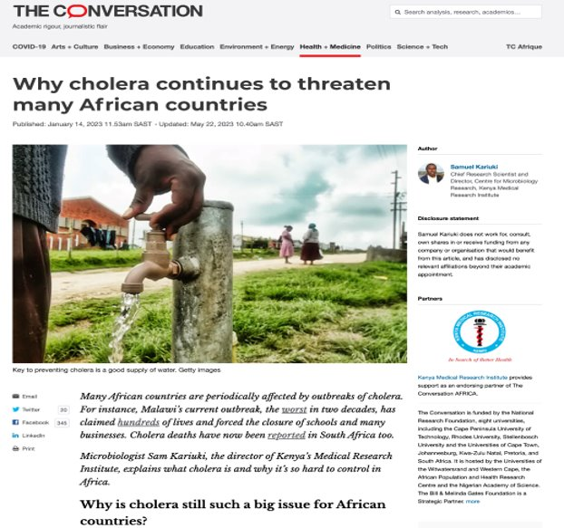
Cholera in Kenya: AMR and Climatic cycles leading to the current outbreaks
Previous Major outbreaks in Kenya: 1981-83, 1997-99, and 2008-2010. ​
Largest outbreak: 1997 and 1998; more than 50,000 infected, case fatality rates 3.8 - 4.7%. ​
These periods coincided with El Niño and La Niña climatic cycles. ​
2021-2022: Flooding in parts of city, followed by prolonged drought and water shortages​
Continuing drought has worsened the situation, access to clean water a huge challenge. ​
As of January 2023, Kenya had recorded 4,713 cases of cholera with 72 deaths accounting for 1.73%.
So far the outbreak has spread to 14 counties across the country.​
The poor WaSH infrastructure (and water shortages) in urban and informal settlements (sewer disposal, open drains) also driving the spread of cholera. ​
Laxity in WaSH habits (especially handwashing after COVID-19) contributing to spread of cholera as faecal-orally transmitted diarrheal disease

Slide 8
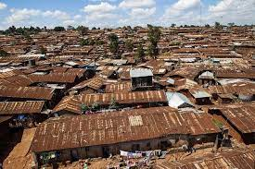
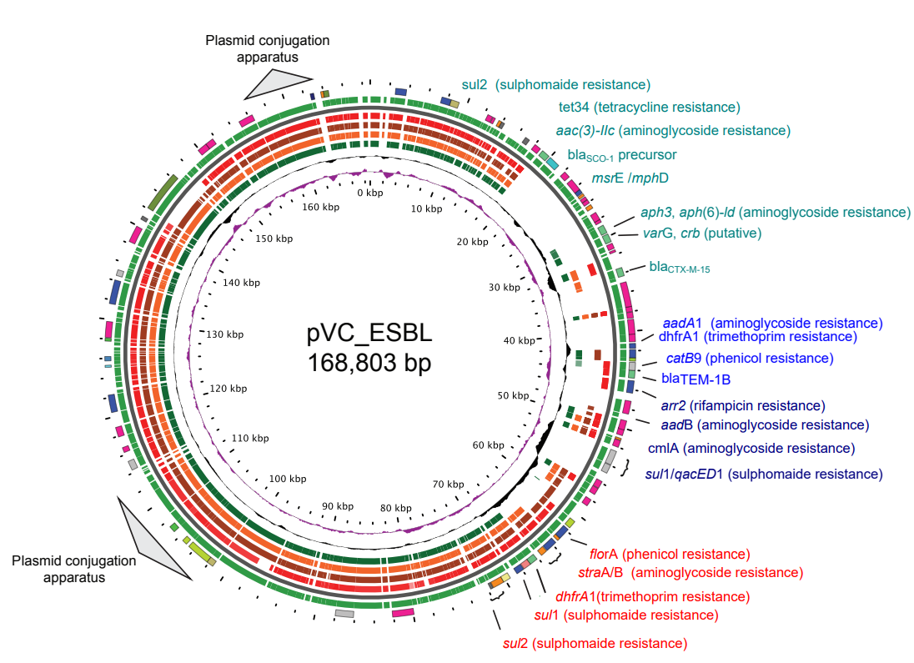
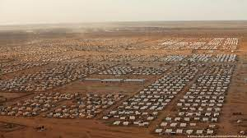
Emergence of MultiDrug-Resistant and ESBL producing V. cholerae
First ESBL strains: Daadab refugee camps in early 2012.
First major outbreak of cholera with the MDR phenotype started in Tana river delta 250 km East of Nairobi in 2015.
Since then ESBL producing Vibrio cholerae have persisted in disease outbreaks in Kenya.
Analysis of our strains showed similarity with strains from the Yemeni outbreak
Disseminating Health Research

Slide 9
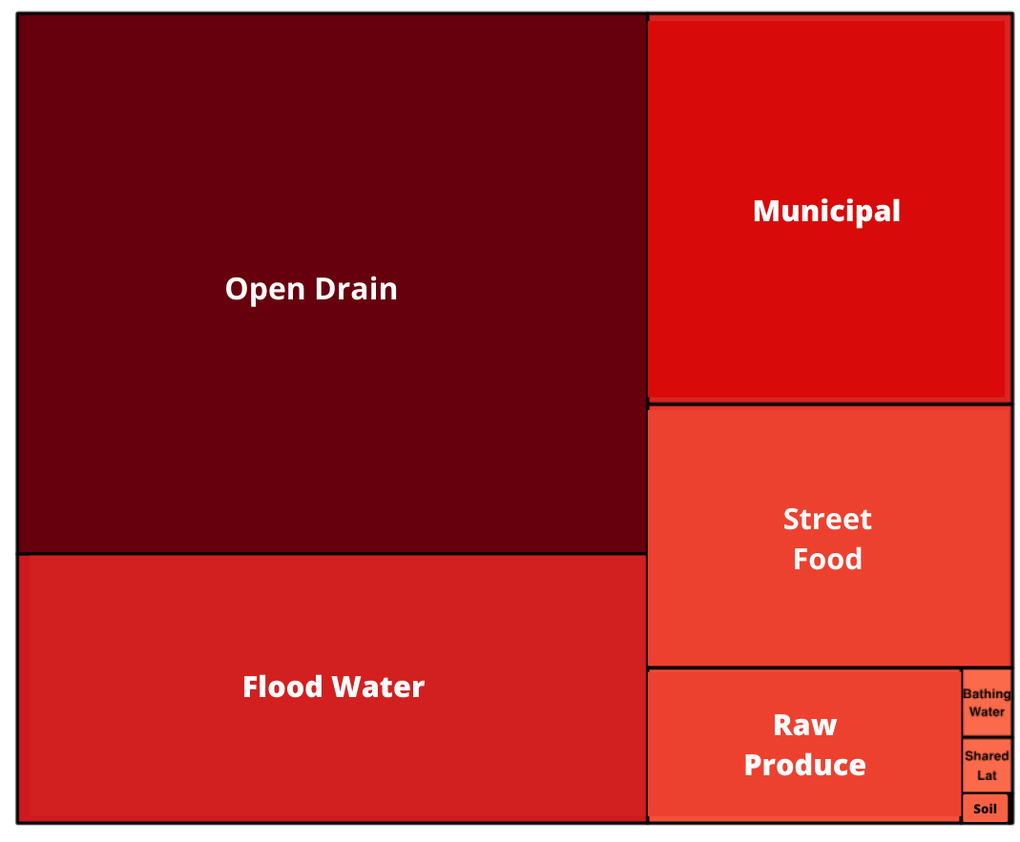
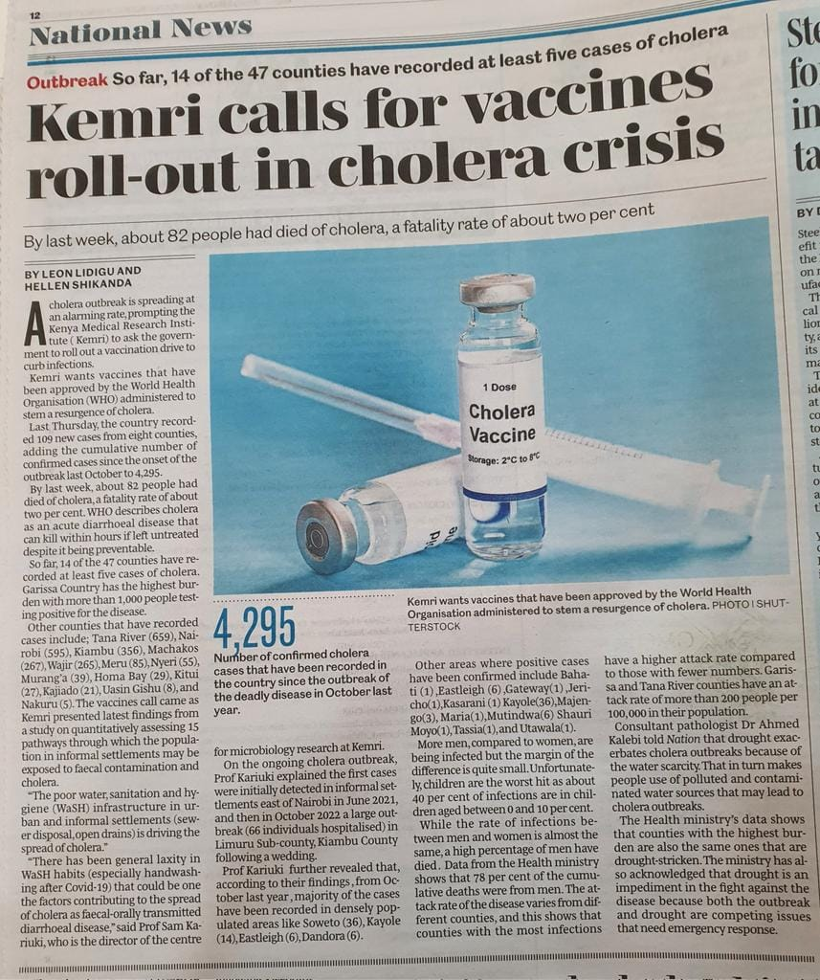

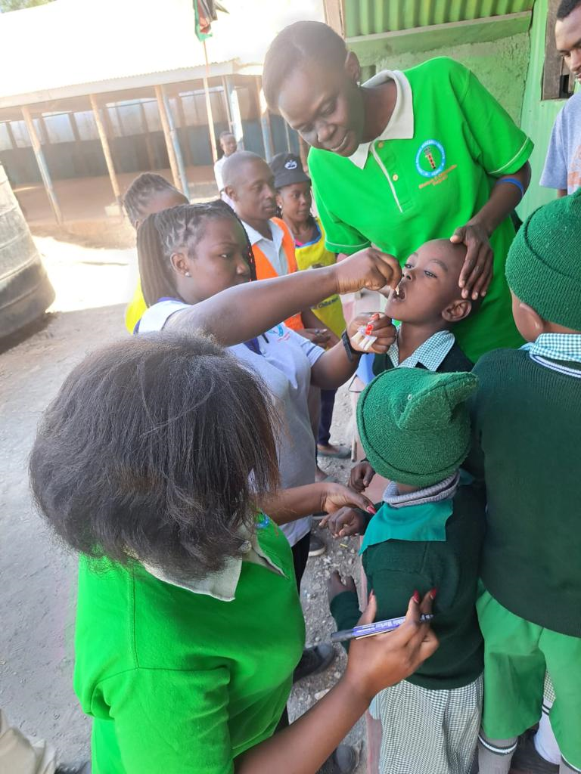
Start with the oral cholera vaccine – immediate arrest of further transmission, Then target reducing exposure from the pathways that pose the greatest risk and are most feasible to intervene.
Multiple Dominant pathways
Improved Open drains
Notes:
This slide shows how exposure differs across the pathways in XXX for adults.
The first plot includes shallow wells and the second one has exposure from shallow wells removed
Can clearly see the dominant pathways as those that are the largest and those that are the darkest red

Slide 10
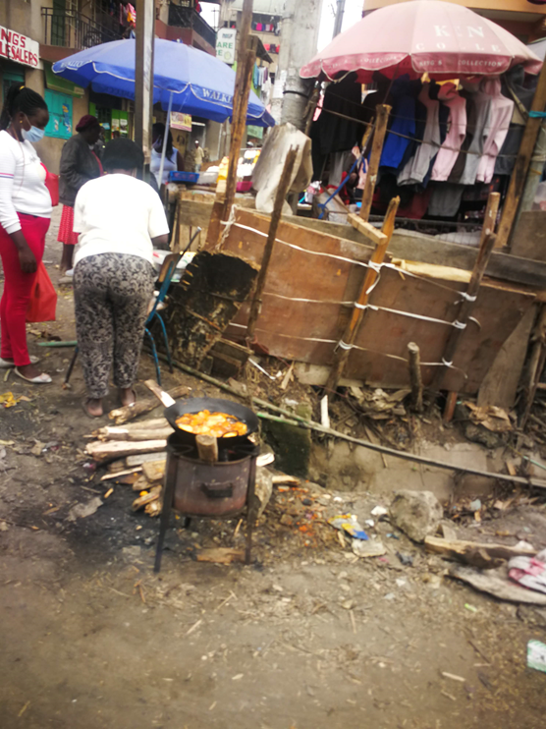
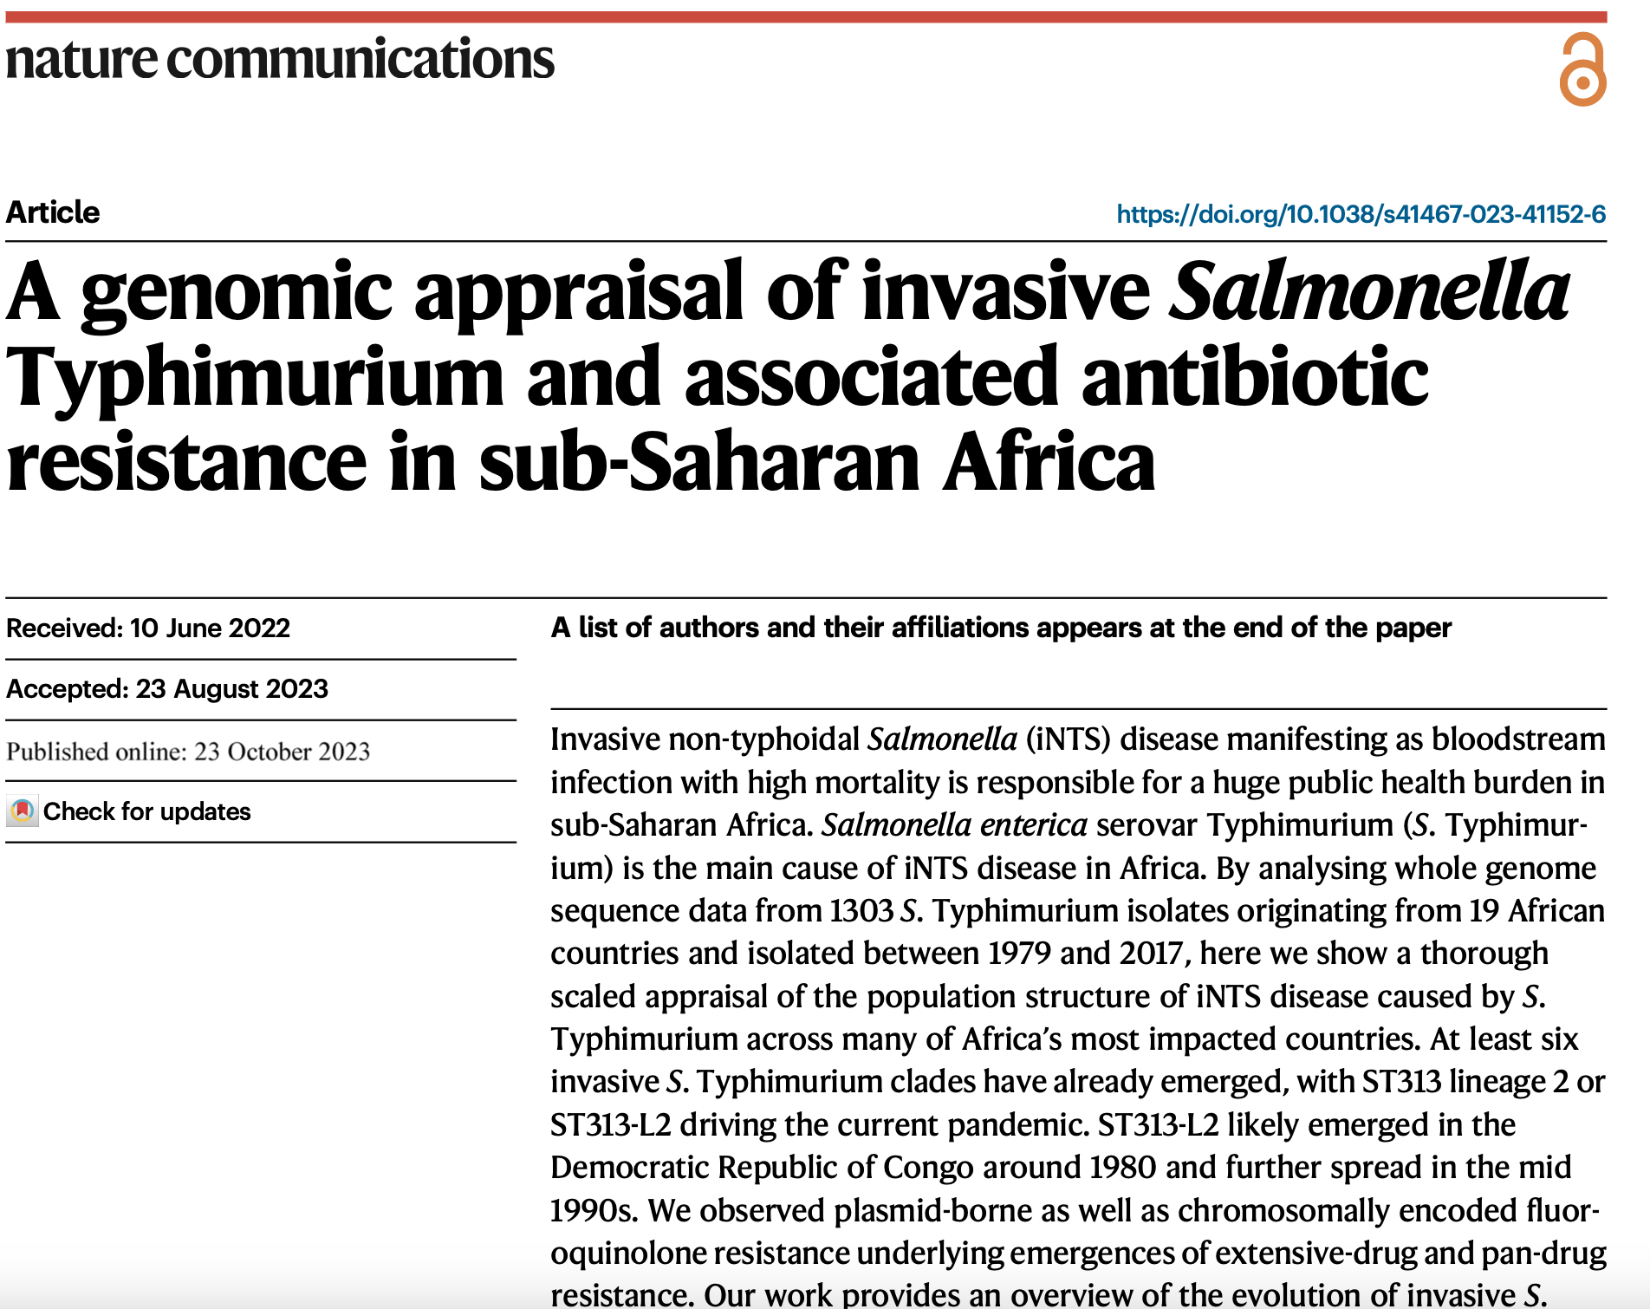
Novel Multidrug resistant NTS strains, recently emerged

Slide 11
Epidemiology of Invasive NTS disease in SSA
iNTS in hospital-admitted children presents as a severe febrile illness with non-specific clinical signs and symptoms (resembling those of severe falciparum malaria).
Respiratory symptoms in ca. 50% of the cases.
iNTS bacteraemia in young febrile children has poor outcome
Upto 28-35% may die within 48h
Although no zoonotic source identified so far, transmission is enhanced in rainy season, poor sanitation and contaminated water source
WHO syndromic guidelines for antibiotic treatment only predict 60% of iNTS.
Challenges in laboratory confirmation in iNTS endemic settings means that iNTS cases are under/mis-diagnosed, leading to high risk of misdiagnosis and undertreatment.
Empirical treatment has led to massive inappropriate use of antibiotics and AMR

Slide 12
MDR spreading and XDR NTS emerging in the SSA
Multidrug resistance (co-resistance to ampicillin, trimethoprim-sulfamethoxazole, and chloramphenicol) is widespread among NTS cases
Third-generation cephalosporin (C3G) resistance and fluoroquinolone non-susceptibility also reported in various countries.
Azithromycin resistance far less studied but some cases from DR Congo.
Acquisition of XDR and PDR involves plasmids highly related to the IncHI2 and IncI1 plasmids.

Slide 13
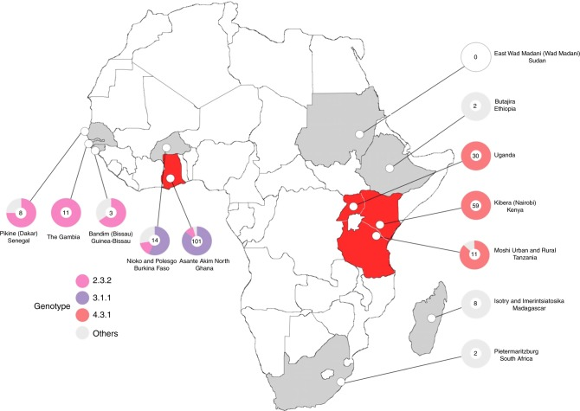
Typhoid fever: MDR H58 S. Typhi clade is now driving the Typhoid epidemic in many regions in Africa
Kariuki et al. ELife. 2021 Sep 13;10:e67852.

Slide 14
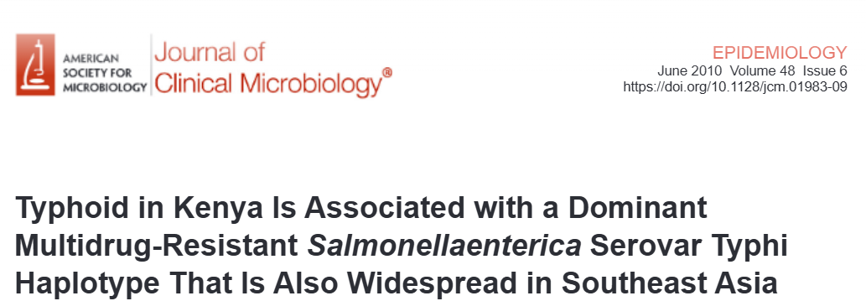
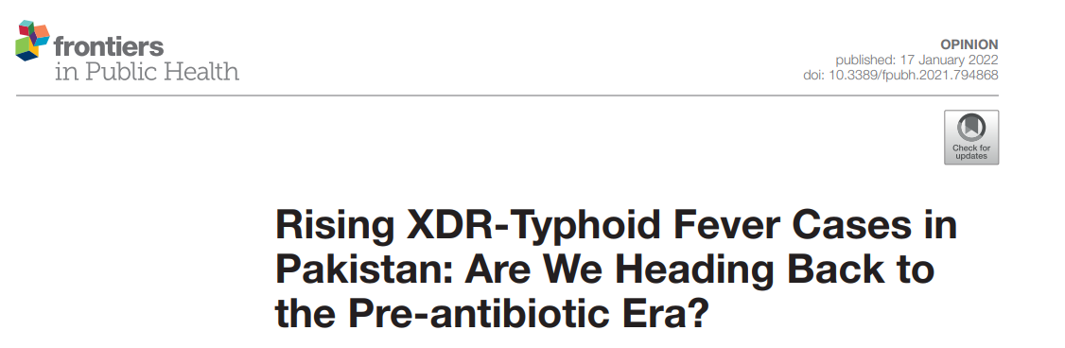

Slide 15
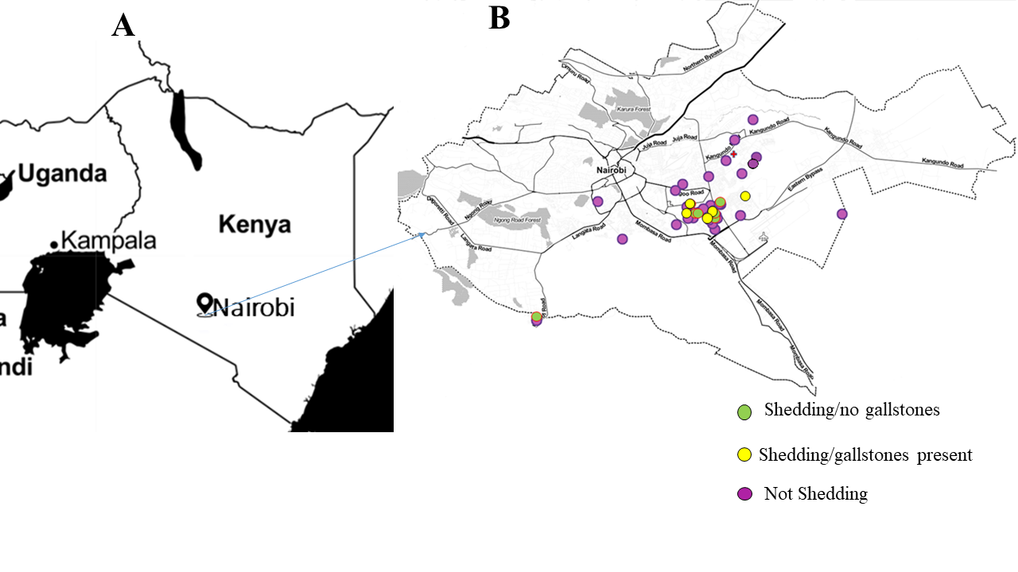
MDR Typhoid carriage hotspots (2020-2024)
Typhoid carriage Hotspots
50% in Mukuru kwa Njenga, 21.4% in Mukuru kwa Ruben 28.5% lived outside Mukuru slums.

Slide 16
AMR in the Livestock sector

Slide 17
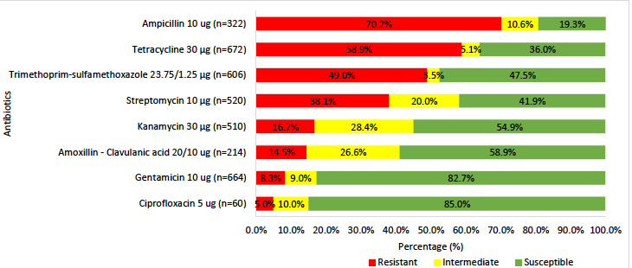
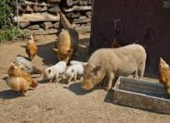
AMR patterns for E. coli from pigs
National AMR Report, (NASIC) 2025

Slide 18
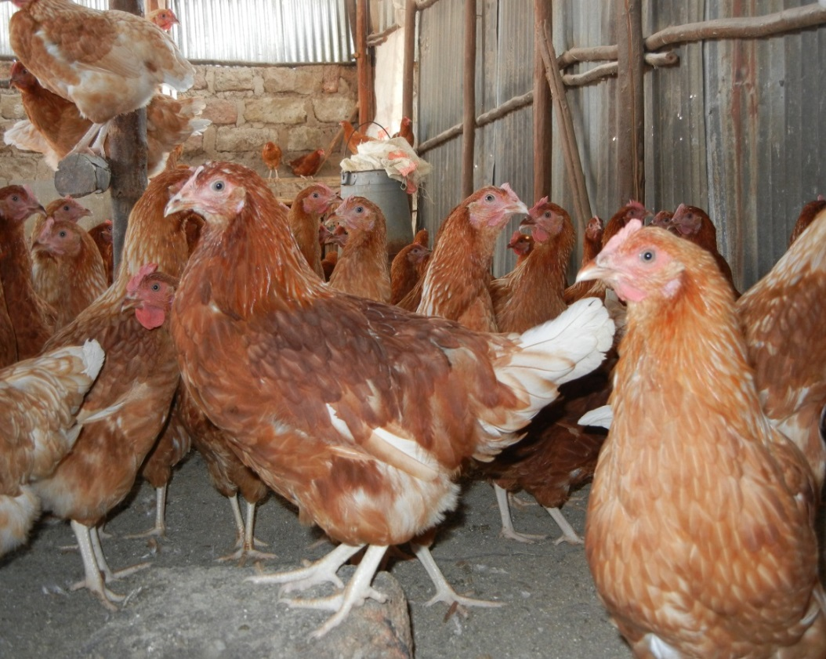
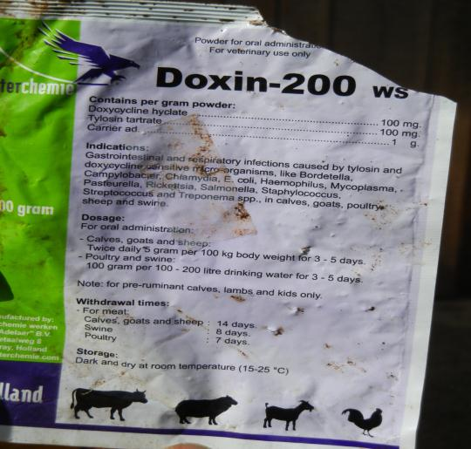
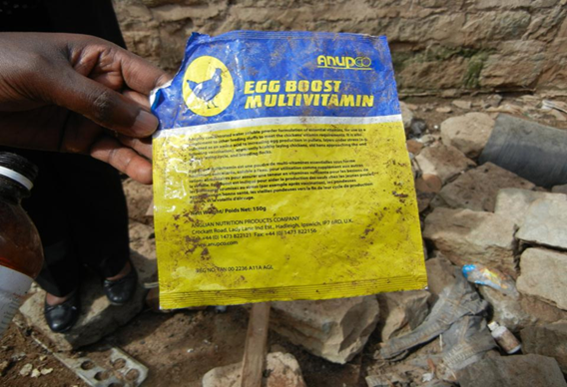
AST patterns for E. coli isolated from chicken processing factory
In livestock farming systems, misuse/overuse abounds!

Slide 19
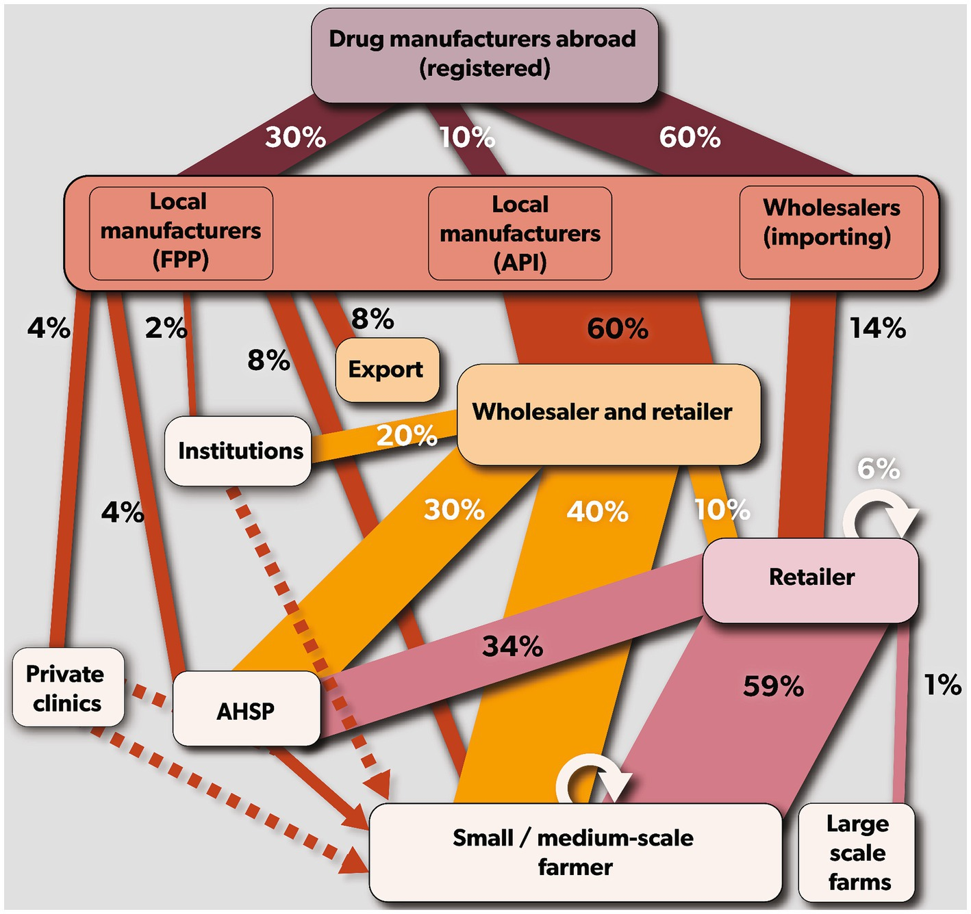
Mapping veterinary antibiotics supply chain in Kenya
Major Classes: Tetracyclines, aminoglycosides, sulfonamides, macrolides, and fluoroquinolones.
Growth in Shipments: A 2025 analysis showed a significant 283% growth in veterinary medicine shipments compared to the prior year.
Poultry farmers reported sharing (14%) antibiotics with each other.
Pig farmers in Ruiru (10%) and Ngong (10%), and Ngong dairy farmers (10%) reported sharing antibiotics.
Use of human designated drugs reported by dairy farmers Gatundu South (10%) and Ngong (5%), and poultry farmers in Ngong (5%).
Morang’a et al. Front. Vet. Sci., 2024

Slide 20
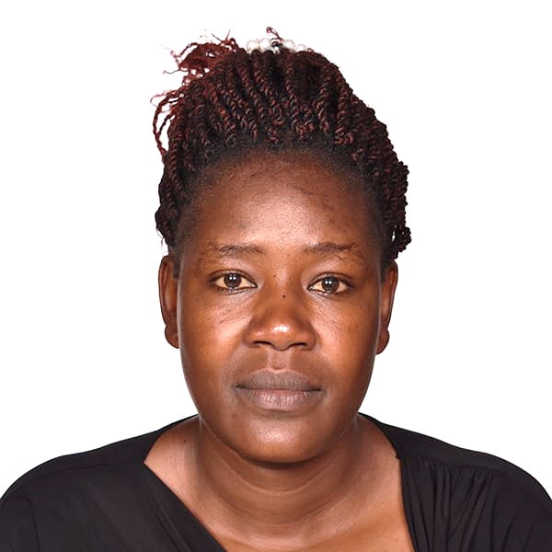
Wastewater Surveillance: High Burden of Carbapenemase producing Enterobacterales
Healthcare-associated bacteria that produce carbapenemase frequently released into wastewater; Raw sewage (n=79, 23.5%), and upstream (n=57, 17%).
Multiple Carbapenemase genes; (n=246, 57%) bla_{NDM}, (n=40, 9%) bla_{KPC}, (n=51, 12%) bla_{VIM}, (n=65, 15%) bla_{OXA}(n=15, 3%) bla_{IMP}, whereas bla _{GES} and bla _{IMP-27} each had (n=7, 2%).
CREs included E.coli, K. pneumoniae, Enterobacters spp, A. baumanii, and Aeromonas spp.
majority of isolates carried multiple carbapenemase genes of bla_{NDM} + bla_{VIM} in more than two combinations.
Consider public health implications for prevention using microbiome technology

Slide 21
Call to Action: opportunities in integrated one-health approaches
Addressing Overuse vs. Lack of Access to Antibiotics in Health and Agriculture
Diagnostic Stewardship and Antimicrobial Stewardship (AMS) in LMICs
IPC strategies in healthcare settings and Farm hygiene/Biosecurity
Vaccine introduction to mitigate against disease burden and AMR
Estimates in LMIC show that we can prevent 7·8% (5·6-11·0) of all AMR-associated mortality in LMICs by IPC, 5·7% (3·7-8·0) by WASH, and 4·2% (3·4-5·1) by vaccination interventions.
Public Awareness and Education must be a continuous process
Future of Antibiotics and the R&D pipeline, renewed interest in AI/ML innovations
Regulatory and Policy Challenges in implementation of NAPs
Economic Impact of AMR for policy action for Africa, to mobilise resources and action
Global Collaborations and Partnerships – commitment of the global south in ensuring sustainable approaches?

Slide 22







Acknowledgment

Slide 23
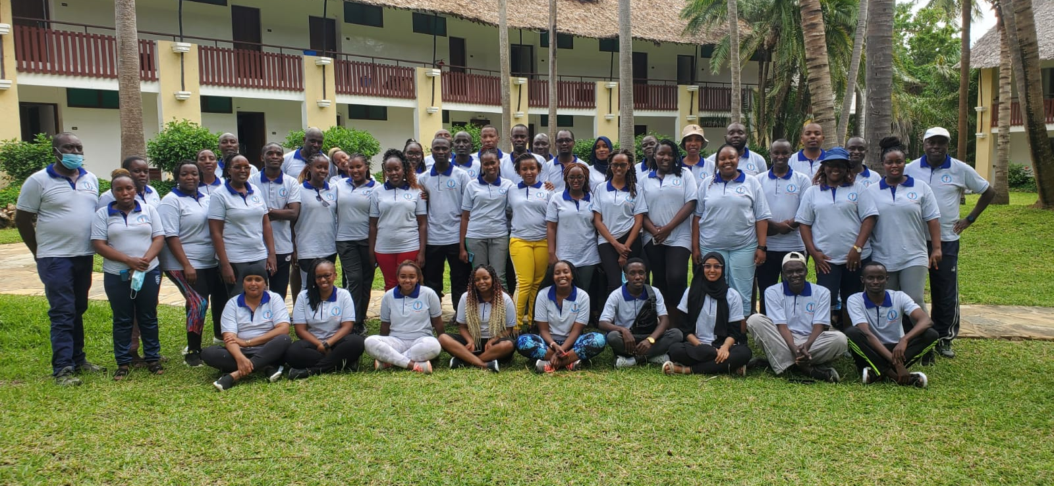
The field and Lab Teams

